Slide 1
Generative Chatbot using Transformer Model
By
Arighna Chakraborty - 511
Shreyashi Chowdhury - 502
Tiyasa Chatterjee - 521
Under the guidance of Dr. Asoke Nath

Slide 2
01
02
Background
Purpose & Scope
03
Applications
Introduction

Slide 3
Background
Natural Languages came into existence for the purpose of being used by humans in order to interact with one another.
Conversational AI combines natural language processing with machine learning to improve the AI algorithms.

Slide 4
Purpose and Scope
The purpose of a Conversational Chatbot is to be able to hold a human like conversation.
The scope of the chatbot built in this project covers the action of conducting casual, friendly conversation with its user.

Slide 5
Applications
Online Customer Support
Health care
Internet of things (IoT) devices
Computer Software

Slide 6
Underlying Concepts

Slide 7
Types of Chatbots
Retrieval Based Chatbots: Retrieval based chatbots communicate using predefined answers. Such chatbot models are provided with a database containing predefined sets of responses.
Generative Chatbots: A generative chatbot is an open-domain chatbot program that generates original combinations of language rather than selecting from predefined responses.

Slide 8
Recurrent Neural Networks
Recurrent Neural Networks are powerful models.
Also known as RNNs.
Capable of dealing sequential data.
Takes fixed-sized vector as input and produce a vector output.
RNNs are called Recurrent.
Performs same task for every element of a sequence where output depends on previous computations.

Slide 9
Long Short Term Memory Networks
Long Short Term Memory networks usually called “LSTMs”.
A special kind of RNN.
Capable of learning long-term dependencies.
Explicitly designed to avoid the vanishing gradient problem

Slide 10
Sequence to Sequence Models
It is a go-to model for Dialogue Systems and Machine Translation.
Consists of two RNNs (more specifically two LSTMs) - An Encoder and a Decoder.
Encoder takes a sequence (sentence) as input and processes one symbol (word) at each timestep.
Output from the encoder is called the context or thought vector.
From the context, decoder generates another sequence, one symbol at a time.

Slide 11
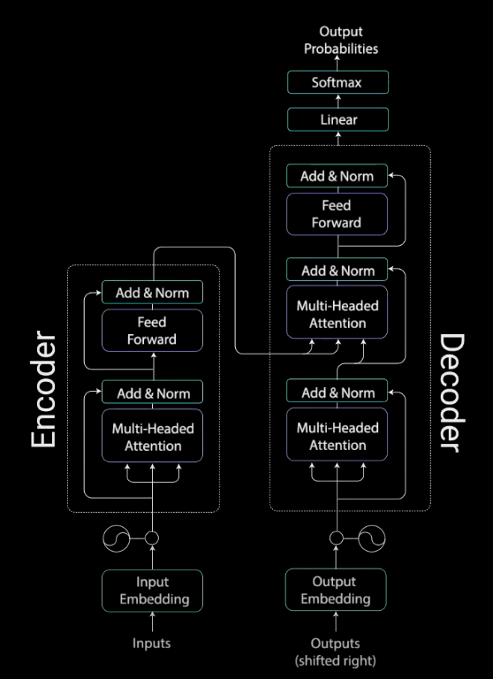
Transformer Model
Most sequence generation models have an encoder-decoder structure.
Follows the same overall architecture using stacked self-attention and point-wise, fully connected layers for both the encoder and decoder.
Self-attention is a mechanism relating different positions of a single sequence to compute a representation of the same sequence.

Slide 12
Challenges
The main challenge for us was to develop a
fully functional open-domain generative
conversational bot from scratch and train it with
satisfying results.
We are planning on incorporating a pre trained
Transformer model to construct our generative module
pipeline and significantly speed up the training and
execution process and completely avoid the heavily
resource intensive training process (only a concept at
this point).

Slide 13
System Design

Slide 14
Transformer Model
The transformer model follows the same overall architecture as Sequence to Sequence using stacked self-attention and point-wise, fully connected layers for both the encoder and decoder.
Input Embeddings
Positional Encoding
Encoder Stack
Decoder Stack

Slide 15
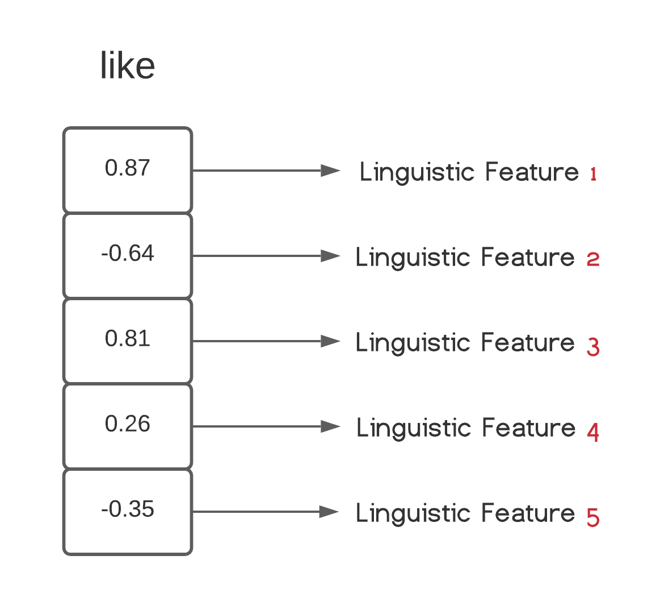
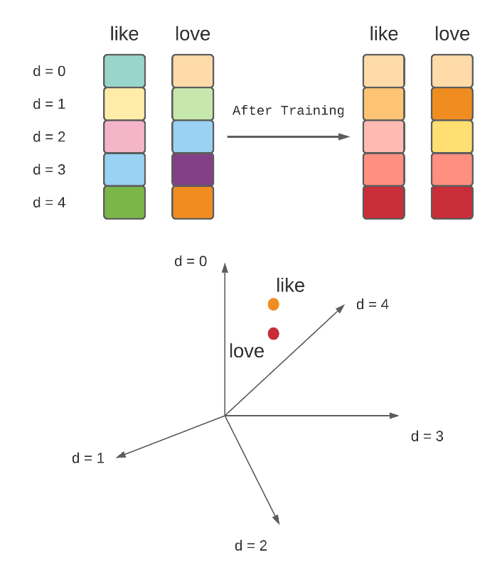
Input Embeddings
The first step is to fetch the indices of the words occuring in the input sequence from a vocabulary
In the input embedding module a vector is generated for each index in the vocabulary.
These vectors are called Word Embeddings
Initially, the vectors are filled with random numbers
The main purpose of the embedding layer is to select the proper embedding of the input words and pass them on to the positional encoding module

Slide 16
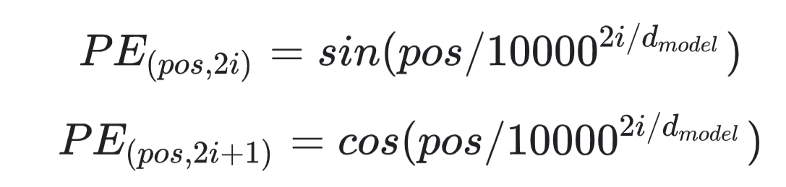
Positional Encoding Module
The model by itself does not have any sense of the position or order for each word.
A new set of vectors called the position embeddings are introduced, one for each word embedding.
These embeddings also contain the position as well as the linguistic informations of the words in the sentence.
The position embeddings and the word embeddings are simply added to generate a new set of embeddings
e₀ p₀ e₁ p₁
i = 0
i = 1
e_{j} – Word Embedding for Word i
p_{j} – Position Embedding for Word i
+
+
i = 2
i = 3
i = 4
Position Embedding (pos = 0)
Position Embedding (pos = 1)

Slide 17
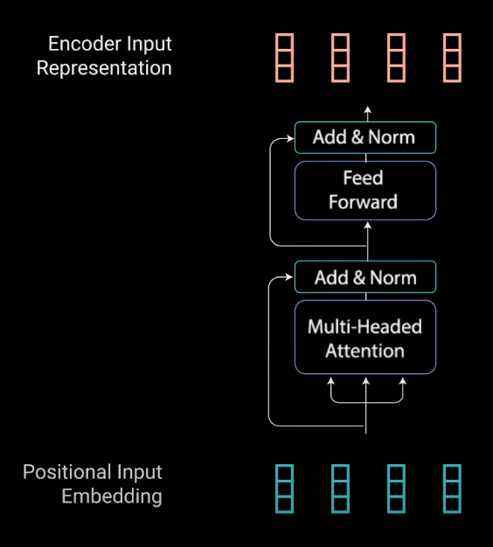
Encoder Stack
The encoder stack consists of a stack of N Encoder Layers.
Each of which has two sublayers – the Multi-Head Attention Layer and the Position-wise Full Connected Feed-Forward Network layer.
Finally each encoder layer has an Add-Norm (Addition and Normalization) layer component.
All the operations inside each encoder stack are implemented to encode the input embeddings to a continuous representation with attention information.

Slide 18
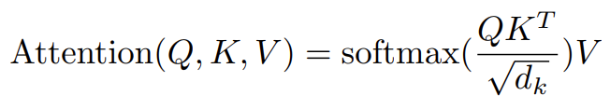
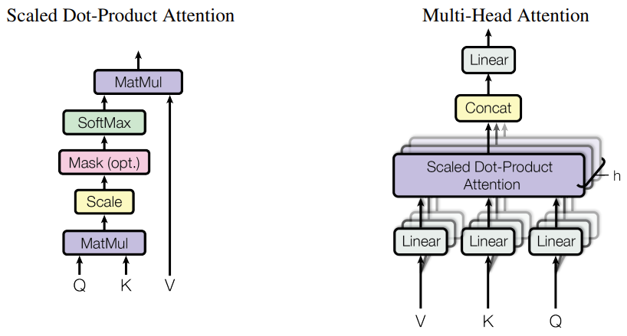
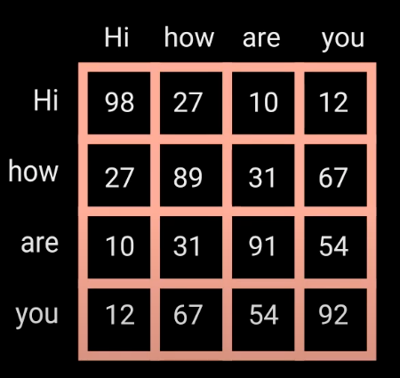
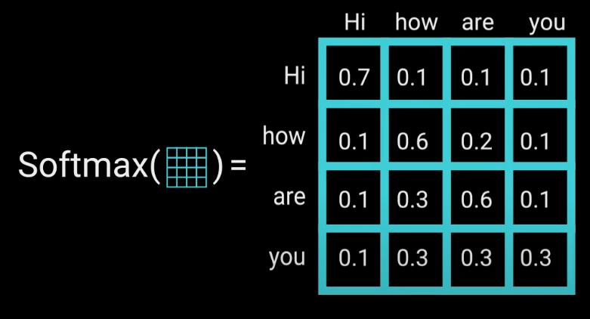
Multi-Head Attention
Self-Attention allows the model to associate each word in the input sequence, to other words.
Three identical copies of the input embeddings are made (K, Q and V)
The queries and keys undergo a dot-product matrix multiplication operation to produce a score matrix.
These scores are scaled down by dividing each score by the square root of the dimension of the query and key
A softmax of the scaled scores is performed to get the attention weights, which outputs probability values between 0 and 1.

Slide 19
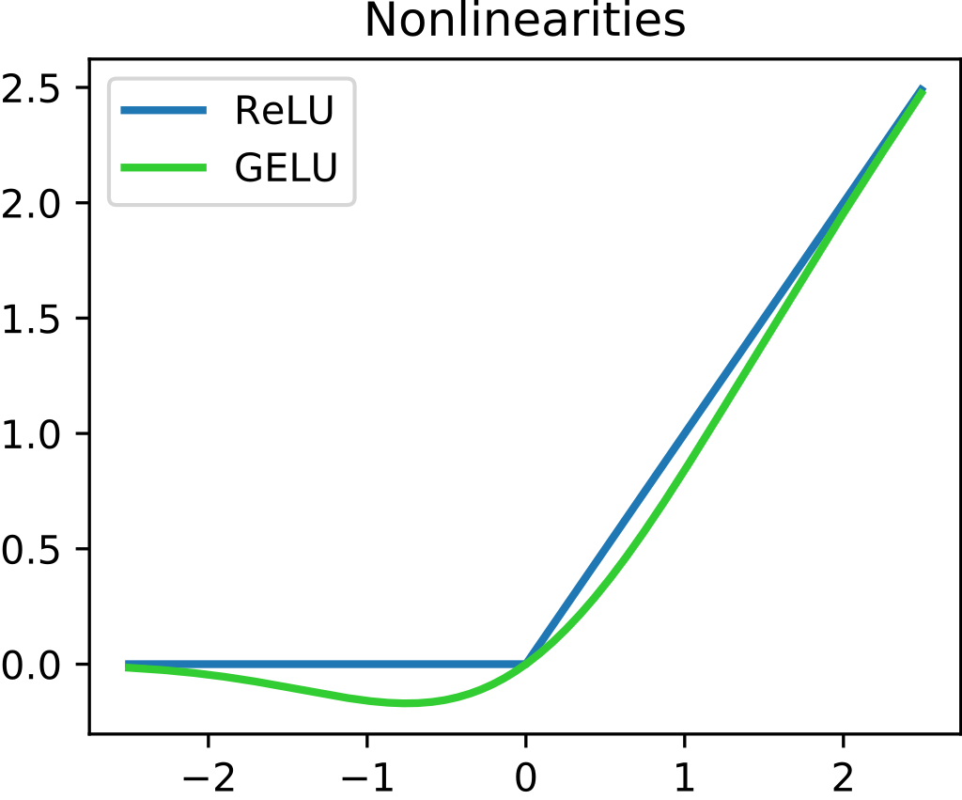
FFN and Layer Normalization
The FFN and normalizing layers helps the network train
The layer normalizations are used to stabilize the network which results in substantially reducing the training time necessary
The pointwise feed-forward network is a couple of linear layers with a ReLU (Rectified Linear Unit) activation function in between.

Slide 20
Decoder Stack
The main purpose of the decoder is to generate text sequences.
These sub-layers behave similarly to the layers in the encoder but there are two multi-headed attention layers and each has a different job.
The beginning of the decoder is pretty much the same as the encoder.
The positional embeddings get fed into the first multi-head attention layer which computes the attention scores for the decoder’s input only.
The second multi-head attention layer operates slightly differently.

Slide 21
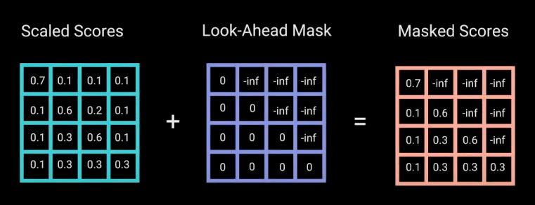
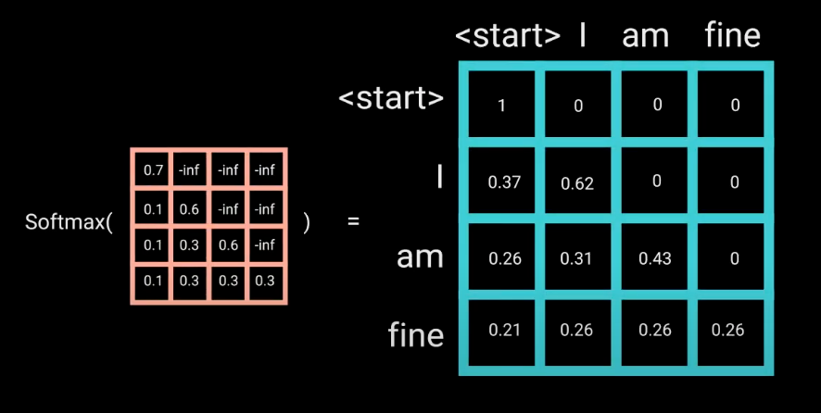
Masked Multi-Head Attention
The decoder generates a sequence word by word.
The model needs to prevent computing attention scores for future word embeddings.
A look-ahead mask is applied to the scaled score matrix
This essentially tells the model to put no focus on those words whose attentions scores are zero.
The encoder’s outputs are the queries and the keys, and the first multi-headed attention layer outputs act as the values.

Slide 22
Flowchart
Training the Transformer Model
Start
Selection of Conversational Dataset for Training the Transformer Model
Writing Code for Conversing with the Transformer Bot
Writing Code for Data Preprocessing for Preparing data for training purpose.
Interacting with the Bot
Writing Code for Creating Training and Testing Data.
End
Writing Code for the Transformer Architecture for Chatbot.

Slide 23
References
Ashish Vaswani, Noam Shazeer, Niki Parmar, Jakob Uszkoreit, Llion Jones, Aidan N. Gomez, Łukasz Kaiser, Illia Polosukhin, “Attention is All You Need”, 6th Dec 2017
Buomsoo Kim, “Attention in Neural Networks”, 11th November 2020
Kyunghyun Cho, Bart vanMerrienboer, Caglar Gulcehre, Dzmitry Bahdanau, Fethi Bougares, Holger Schwenk, Yoshua Bengio, “Learning Phrase Representations using RNN Encoder–Decoder for Statistical Machine Translation”, 3rd June 2014
Michael Phi, Illustrated Guide to Transformers- Step by Step Explanation, 1st May 2020
Complete list of References can be found in the project documentation

Slide 24
Thank You

